Slide 1
Travel ai agent
IBM HACKATHON PROJECT
Presented By:
Student name :Shreya Yadav
College Name & Department :Shri Ramswaroop Memorial University
& Bachelor of Technology in Computer Science

Slide 2
OUTLINE
Problem Statement
Technology used
Wow factor
End users
Result
Conclusion
Git-hub Link
Future scope
IBM Certifications

Slide 3
Problem Statement
The Challenge – An Eco Lifestyle Agent, powered by RAG (Retrieval-Augmented Generation), empowers users to adopt a greener lifestyle through personalized, practical suggestions. It retrieves sustainable living tips, eco-friendly product recommendations, local recycling guidelines, and government schemes from trusted environmental sources. Users can ask natural language questions such as “How can I reduce plastic use at home?” or “What are eco-friendly travel options in my city?” and receive instant, actionable guidance. The agent promotes small daily actions with big environmental impact, making sustainability easy and accessible. This AI-driven assistant fosters eco-conscious decisions, raises awareness, and helps build a more sustainable future.

Slide 4
Technology used
IBM cloud lite services
Natural Language Processing (NLP)
Retrieval Augmented Generation (RAG)
IBM Granite model

Slide 5
IBM cloud services used
IBM Cloud Watsonx AI Studio
IBM Cloud Watsonx AI runtime
IBM Cloud Agent Lab
IBM Granite foundation model

Slide 6
Wow factors
The Eco Lifestyle Agent doesn’t just answer questions — it acts as a personal green coach, using AI + real-time data to turn complex sustainability challenges into simple, daily habits anyone can follow.
By combining RAG technology with IBM Granite on IBM Cloud Lite, it delivers hyper-personalized, location-aware, and trustworthy eco-guidance in seconds — making it feel less like a chatbot and more like a smart, eco-conscious companion for your everyday life.

Slide 7
End users
Academic Researchers
Research Institutions and Universities
Industry R&D Teams
Educators

Slide 8
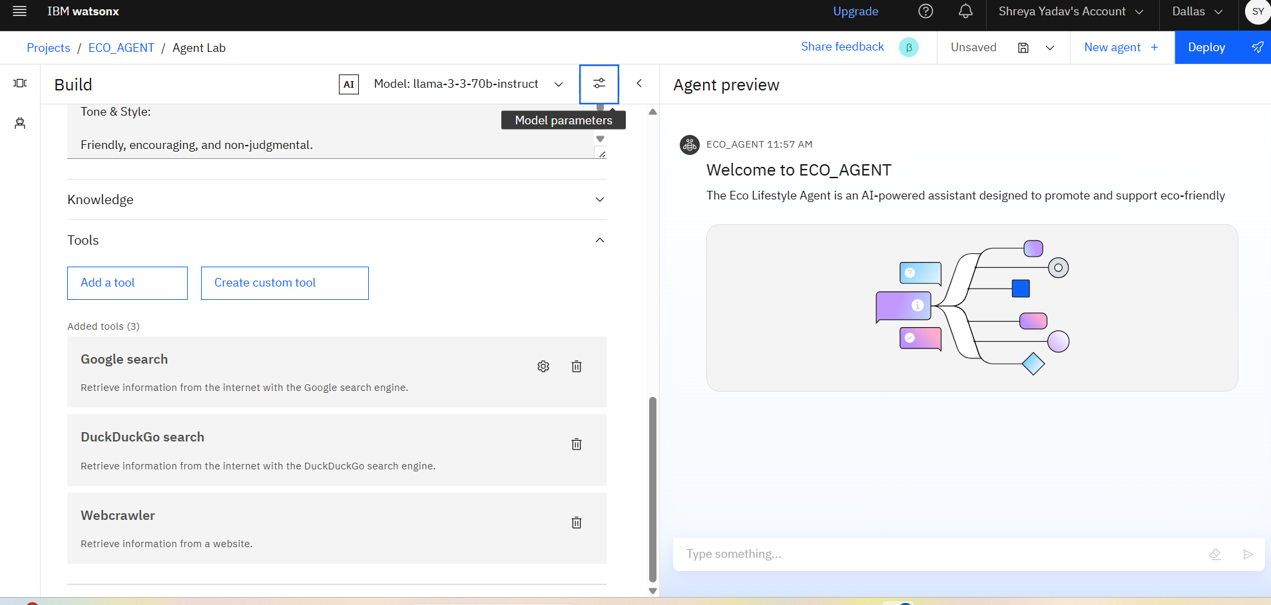
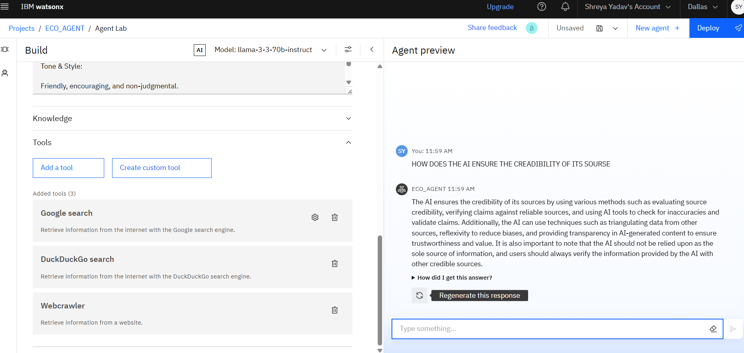
Results

Slide 9
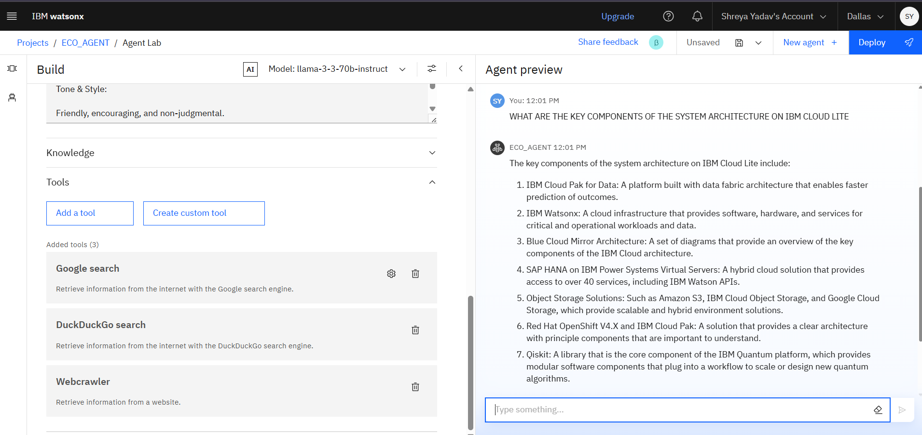
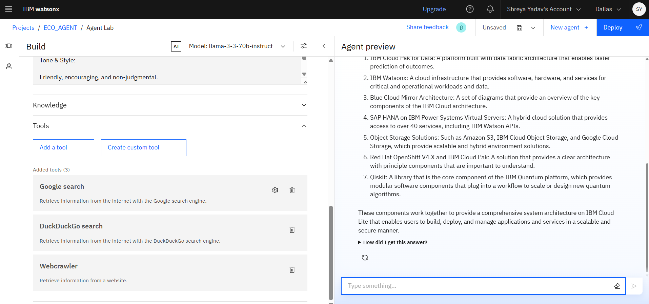
Results

Slide 10
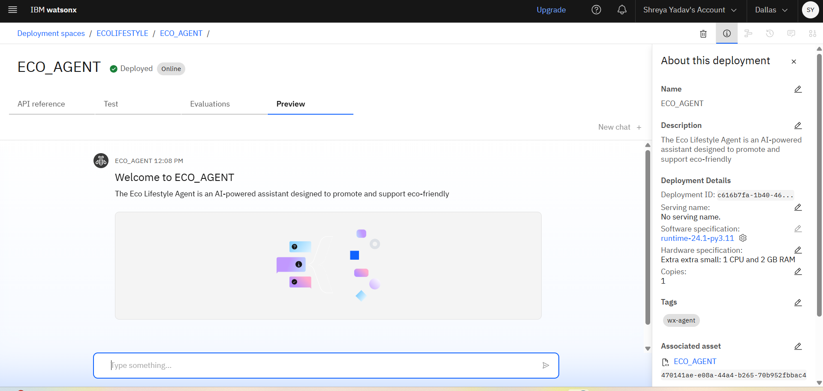
Results

Slide 11
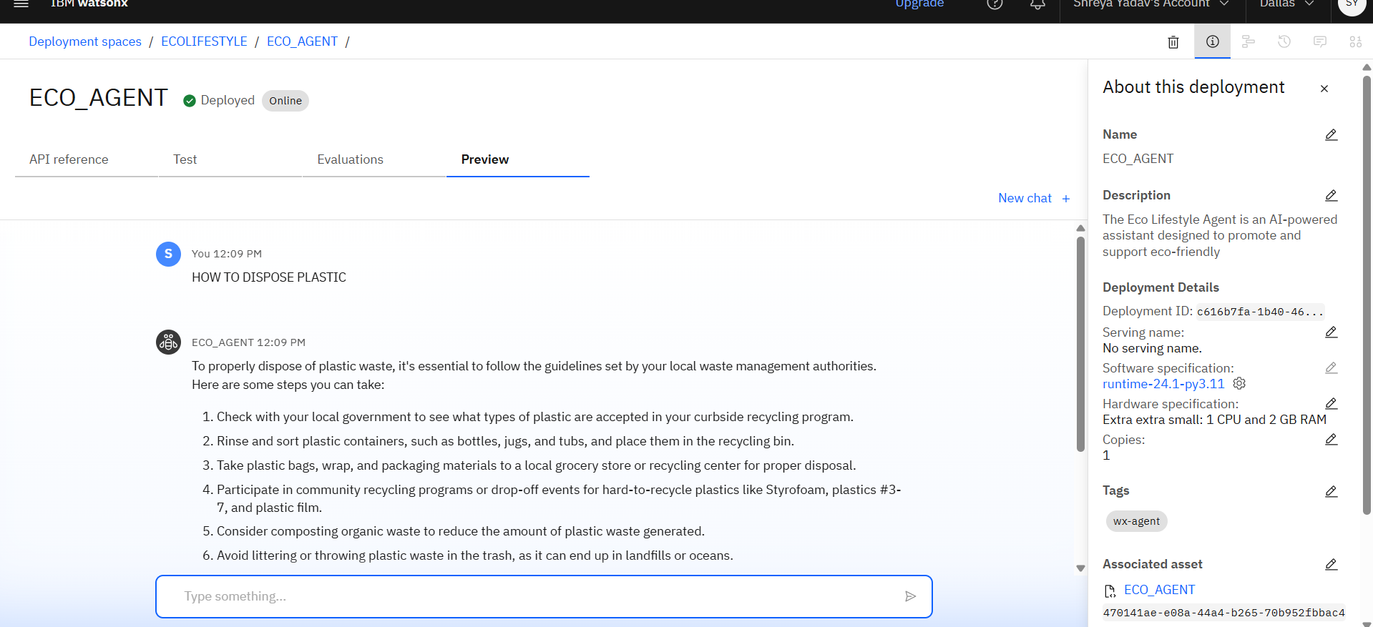
Results
Deployed AI Agent

Slide 12
Conclusion
The Eco Lifestyle Agent is a powerful step toward making sustainability practical, personal, and accessible for everyone. By leveraging IBM Granite and RAG on IBM Cloud Lite, it transforms complex environmental data into simple, actionable guidance. With its friendly tone, real-time information, and personalized support, the agent empowers users to make small choices that lead to big environmental impact—paving the way for a smarter, greener, and more responsible future.

Slide 13
GitHub Link
Make sure that there should be readme file

Slide 14
Future scope
Multilingual Research Support
Voice-Activated Research Assistant
Real-Time Collaboration Features
Research Gap and Novel Topic Identification
Integration with Publishing Platforms
AI-Assisted Paper Drafting

Slide 15
IBM Certifications
Screenshot/ credly certificate( getting started with AI)

Slide 16
Attach your RAG LAB certificate here

Slide 17
THANK YOU

